Slide 1
Services and Services System
Service-Oriented Software Engineering
Software Institute
Nanjing University
Bei Jia

Slide 2
What is service
James Fitzimmons, Service management
  A service is a time-perishable, intangible experience performed for a customer acting in the role of co-producer
Christian Gronroos, Service Management and Marketing: A Customer Relationship Management Approach
  A service is an activity or series of activities of more or less intangible nature that normally, but not necessarily, take place in interactions between customer and service employees and/or physical resources or goods and/or systems of the service provider, which are provided as solutions to customer problems

Slide 3
Services examples
Traditional transportation and warehousing
Information
Finance, stock market
Rental and leasing
Scientific and technical services
Administration
Entertainments
……

Slide 4
Service vs. Manufacturing Model (1/2)
Outputs: Services vs. Goods

Slide 5
Service vs. Manufacturing Model (2/2)
A precise definition of goods and services should distinguish them on the basis of their attributes
  A good is a tangible physical object or product that can be created and transferred; it has an existence over time and thus can be created and used later
  A service is intangible and perishable. It is an occurrence or process that is created and used simultaneously or nearly simultaneously. While the consumer cannot retain the actual service after it is produced, the effort of service can be retained

Slide 6
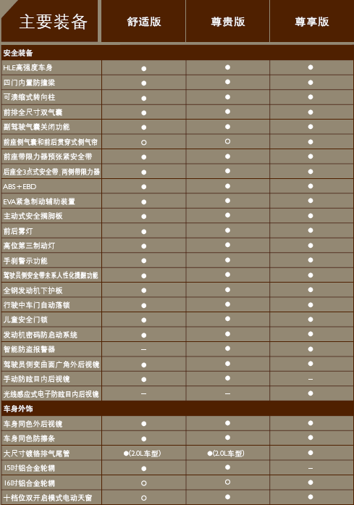
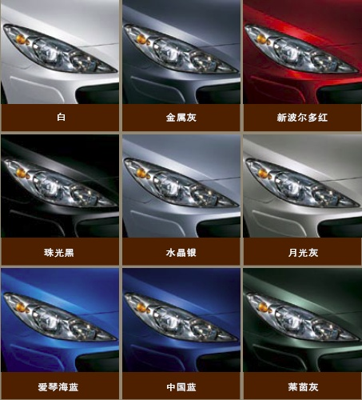
Integration of Manufacturing and service (1/5)

Slide 7
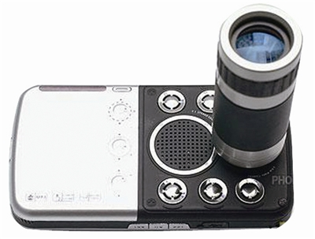
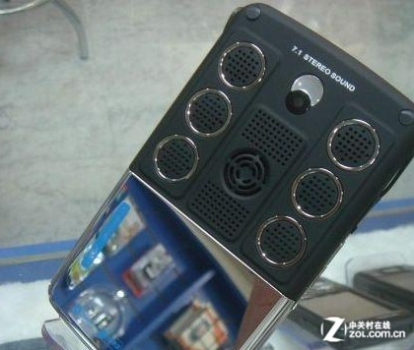
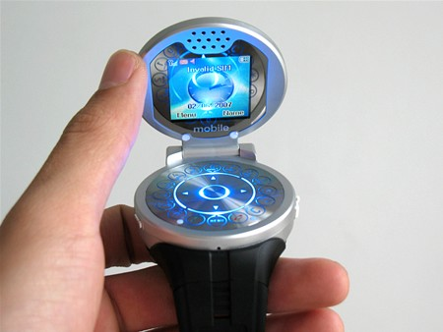
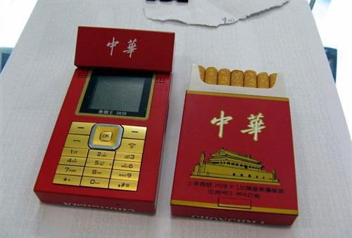
Integration of Manufacturing and service (2/5)

Slide 8
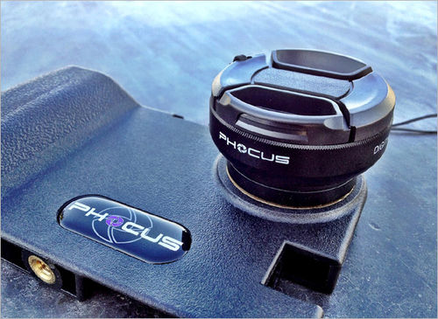
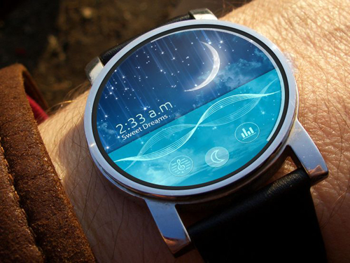
Integration of Manufacturing and service (3/5)

Slide 9
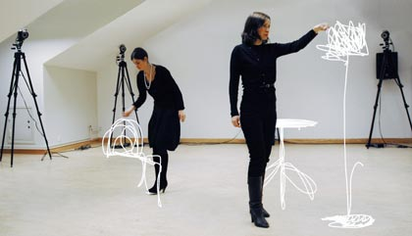
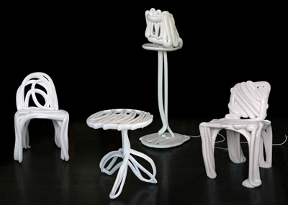
Integration of Manufacturing and service (4/5)

Slide 10
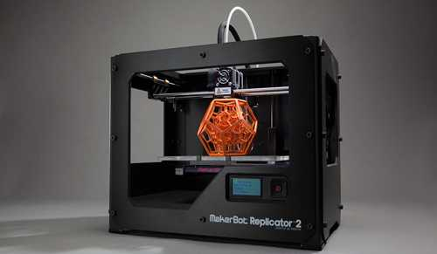
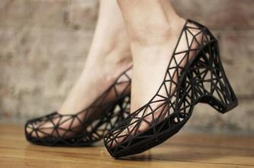
Integration of Manufacturing and service (5/5)

Slide 11
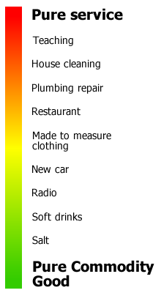
Service-goods continuum

Slide 12
Trend (1/2)
Pure Manufacturing decreases
Service industry arises
  Property service
  Security ensuring
  Gardening
  Cleaning work
  Maintaining and fixing
  ……
  Software developing (Outsourcing model) included

Slide 13
Trend (2/2)
Services are becoming more and more complex
  Call in center of bank (with support system)
  Hospital which offers medical services (with HIS)
  Complex enterprise management (with ERP, CRM and so on…)
  e-bank or e-commerce (B2C, B2B)
  ……
IT system is introduced
  With or without service employees

Slide 14
Services System
IT software system that realizes business services
  A considerable number of software systems are services systems
Informally defined as 6-tuples
  Inputs
  Outputs
  Goals (Internal/External)
  Transformation
  Components
  Sensors

Slide 15
Components
Service people
  Designer
  Developer
  Tester and so on
Service partners
  Customers if needed
  Service employee if needed
Service Information
Service activates
Service infrastructure resources (Physical/IT/Abstract)

Slide 16
Self Contained & Encapsulated

Slide 17
Perspectives of service systems (1/2)
Model
  Service Operation Model
  Service Delivery Model
  Service Capacity Model
Technology
  Traditional Software Technology and Method
  Web Services/SOA
  Grid
  Autonomic Computing

Slide 18
Perspectives of service systems (2/2)
Architecture
  Data architecture
  Application architecture
  Performance architecture
Optimization
  Operational research
  Complex system
  System engineering

Slide 19
Problems in Services System
The complexity of services system
The flexibility of services system
Specialization and outsourcing model
The evolvement of computing environment
The gap between IT specialists and business specialists
New values added and innovative functions
Series of services systems with slightly difference (product families, product line)

Slide 20
IT-enabled business service
When business service is provided with services systems, it is IT-enabled
Services represent a type of relationships-based interactions (activities) between at least one service provider and one service consumer to achieve a certain business goal or solution objective
  Operation model
  Charge model

Slide 21
2 features of IT-enabled Service
Service operation models
  End to end model
  Hosted service model
  Business process outsourcing
  Data-centered outsourcing
  Service through online broker agency
Service charge models (can be multi-leveled)
  Free-of charge model
  Fee-based model
  Government service model

Slide 22
IT and Non-IT Services
Common features
  The same principle of a services lifecycle
  The same set of elements of a services system
Major difference
  Key performance indicators (KPIs)
  Requirements managements
  The paces of changes

Slide 23
Services Ecosystem
From the view of consumers
  There are many services can be utilized simultaneously and independently
  So they are called vertical services
  Divided into pure IT services and IT-enabled services
Vertical services can be constructed with some reusable cross-industry common services
  So they are called horizontal services
  Divided into common business services and IT services

Slide 24
Overview of a services ecosystem

Slide 25
The Question is …
How to leverage limited resources to build and maintain proper services systems?
That is…. how to build and maintain a proper services ecosystem/Service inventory?

Slide 26
Read more…
题名/责任者:Services computing = 服务计算 / Liang-Jie Zhang, Jia Zhang, Hong Cai.
出版发行项:Beijing : Tsinghua University Press ; Berlin ; New York : Springer, c2007.
ISBN:9787302150756 (Tsinghua University Press)
ISBN:9783540382812 (Springer)

